Slide 1

Accessibility of Regent Street and its Impact on Retail Property Rents: A Multidimensional Analysis
Yue Ma
Department of Informatics
Supervisor: Nicolas Holliman KPMG BODS Graduation Scheme

Slide 2
Background
The Future of Regent Street Project:
Participants: The Crown Estate & Westminster City Council
Aim: To find a permanent solution to make Regent Street greener, safer, and more accessible

Slide 3
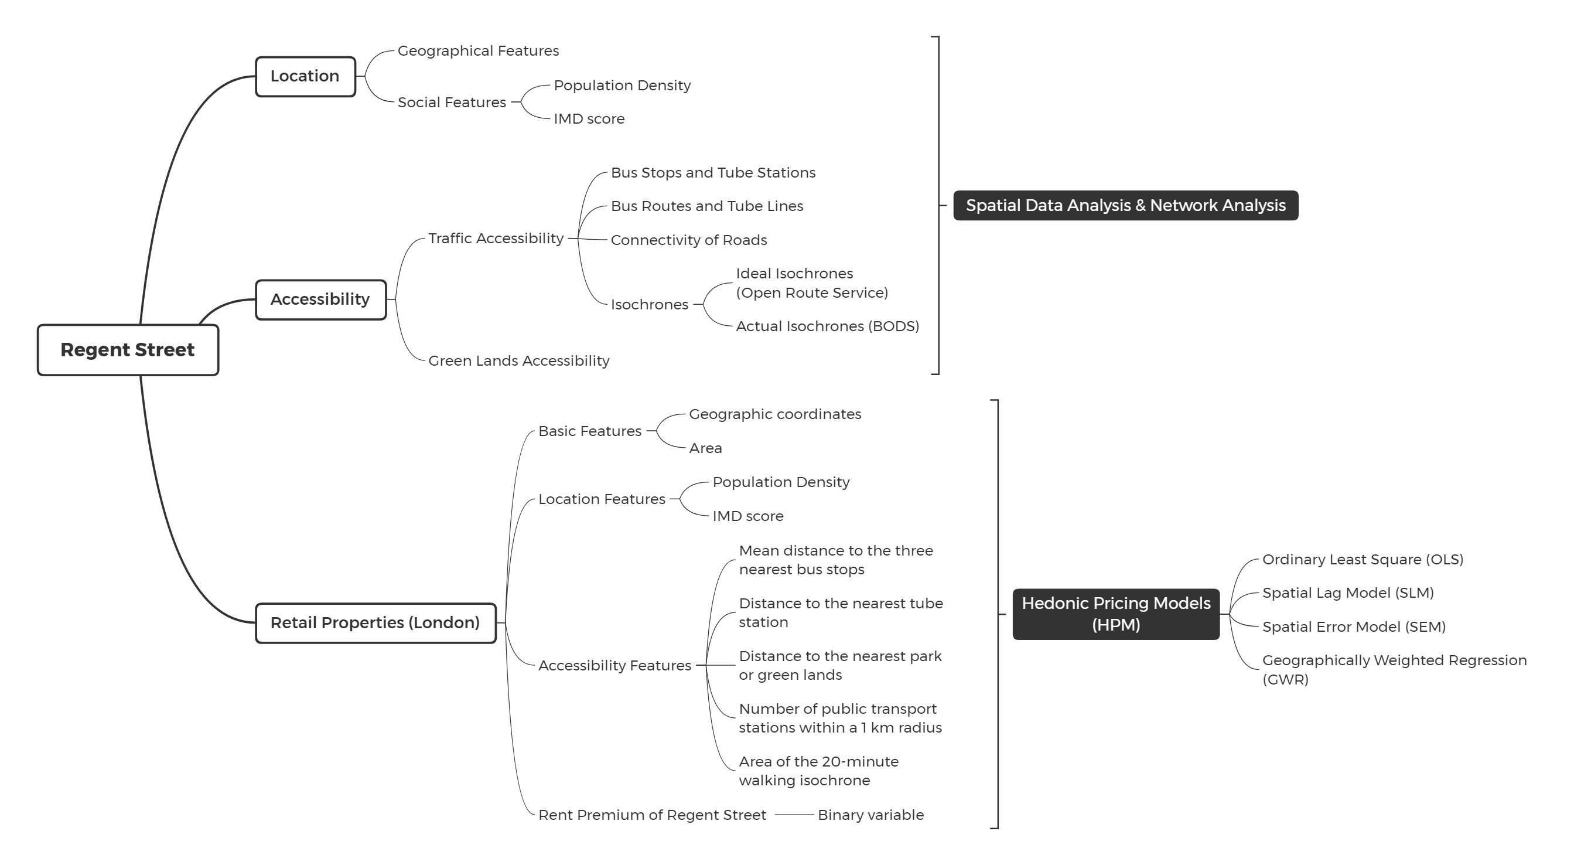

Slide 4
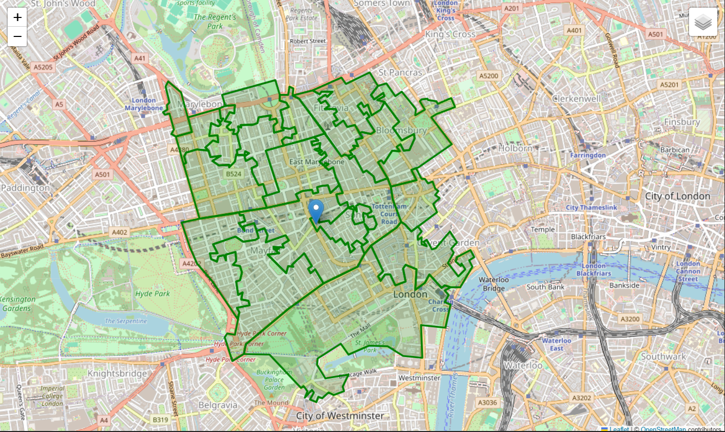
Location
Study Region:
20 LSOA areas
5.58 km²

Slide 5
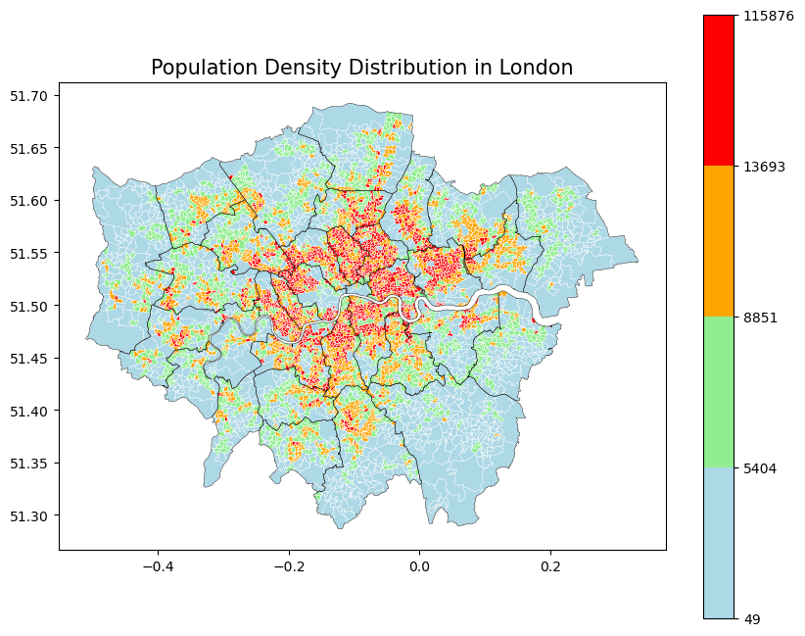
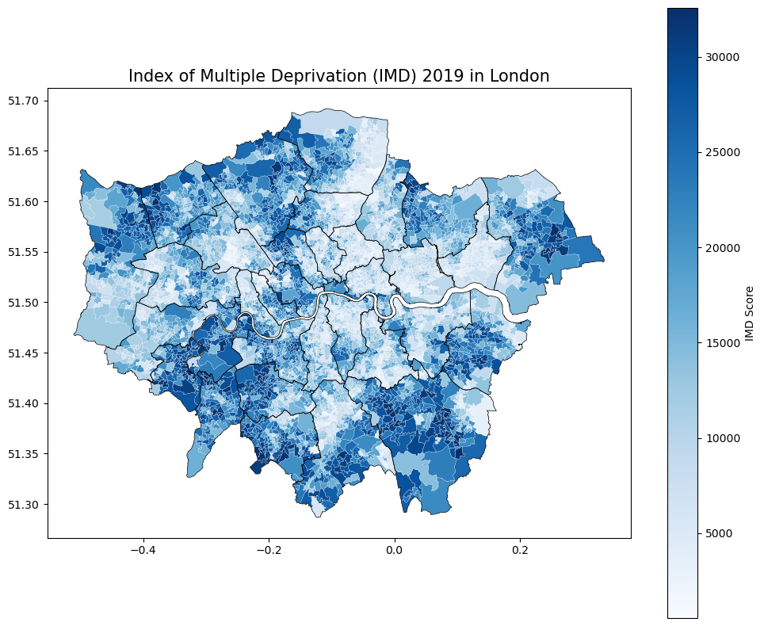
Social Features
Reversed trends in population density and IMD score

Slide 6
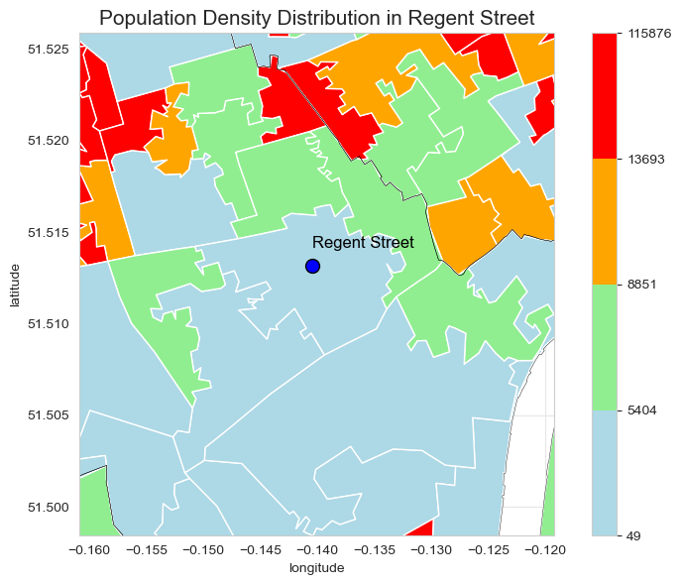
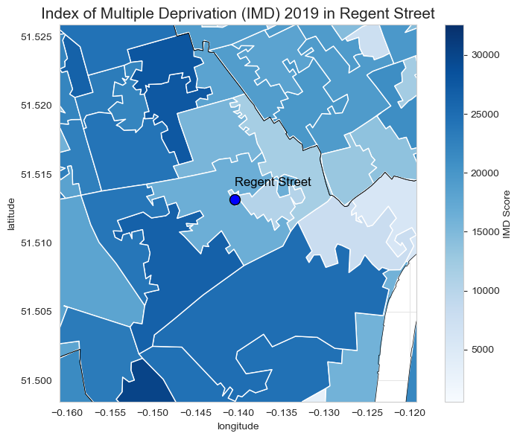
Social Features
Reversed trends in population density and IMD score

Slide 7
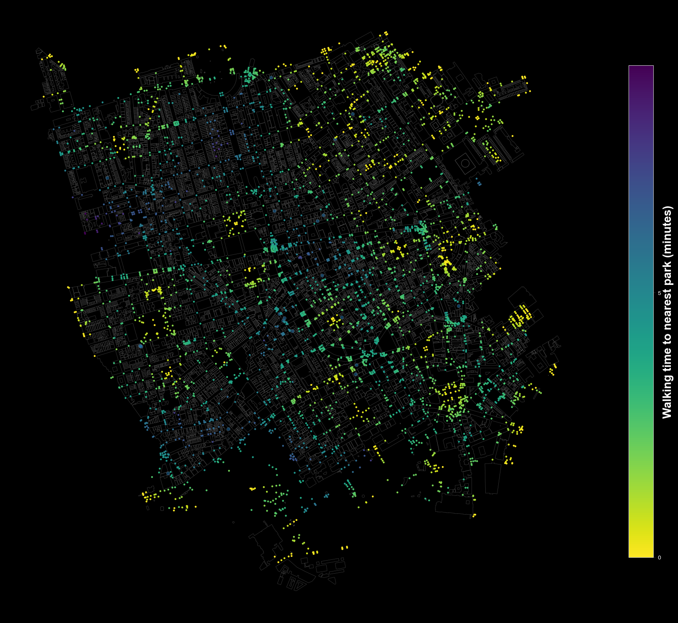
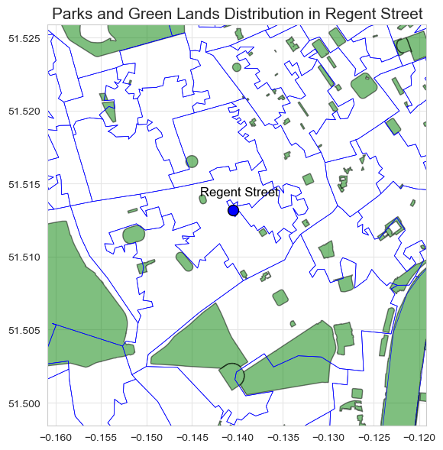
Green Space Accessibility
Green space proportion is relatively low (6.14%<16.49%)
Green mosaics can be planned in positions with lower park accessibility
0.34 km²

Slide 8
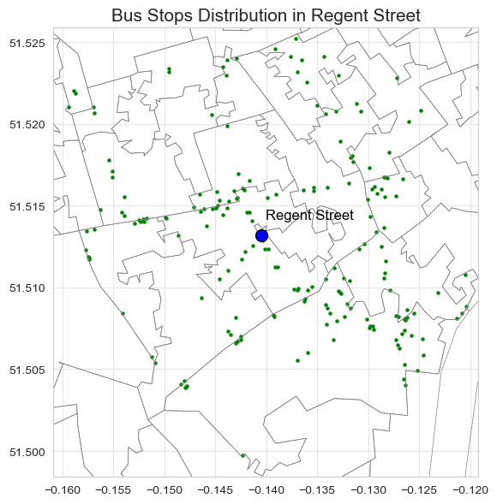
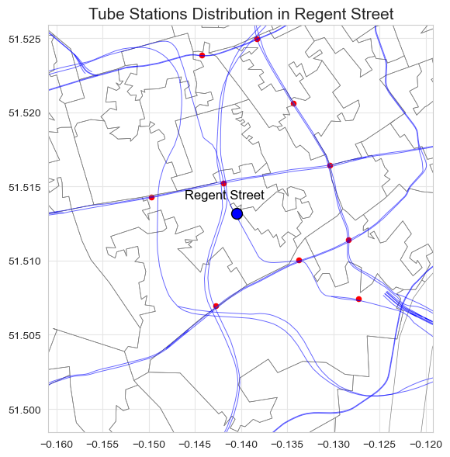
Traffic Accessibility – Stops & Stations
190 bus stops
10 tube stations
Tube line network

Slide 9
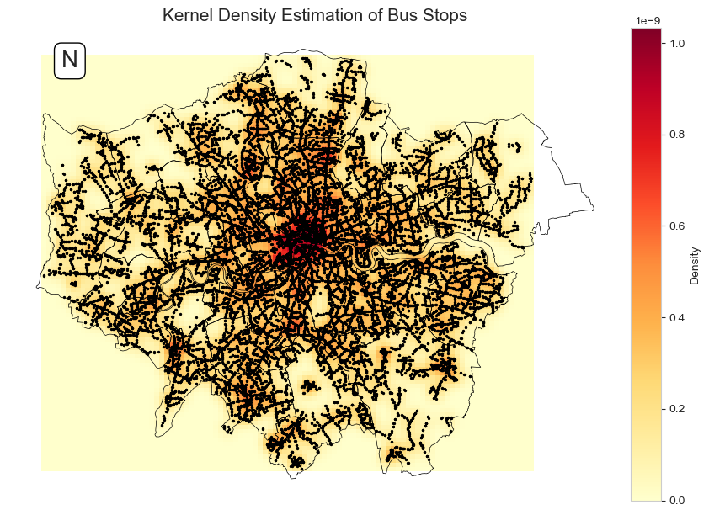
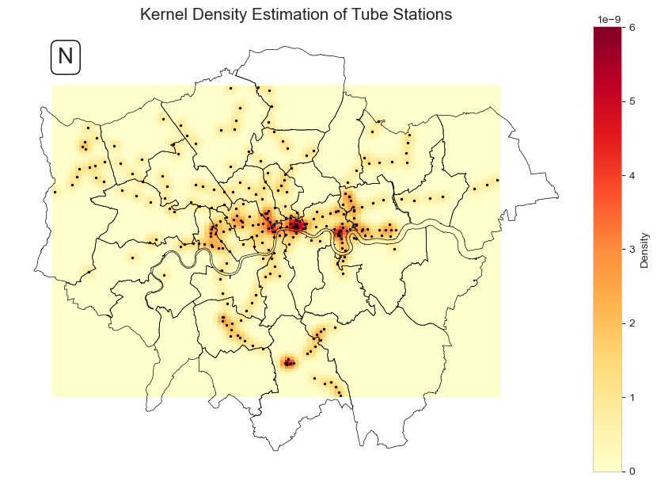
Traffic Accessibility – Stops & Stations
Cluster patterns of bus stops and tube stations

Slide 10
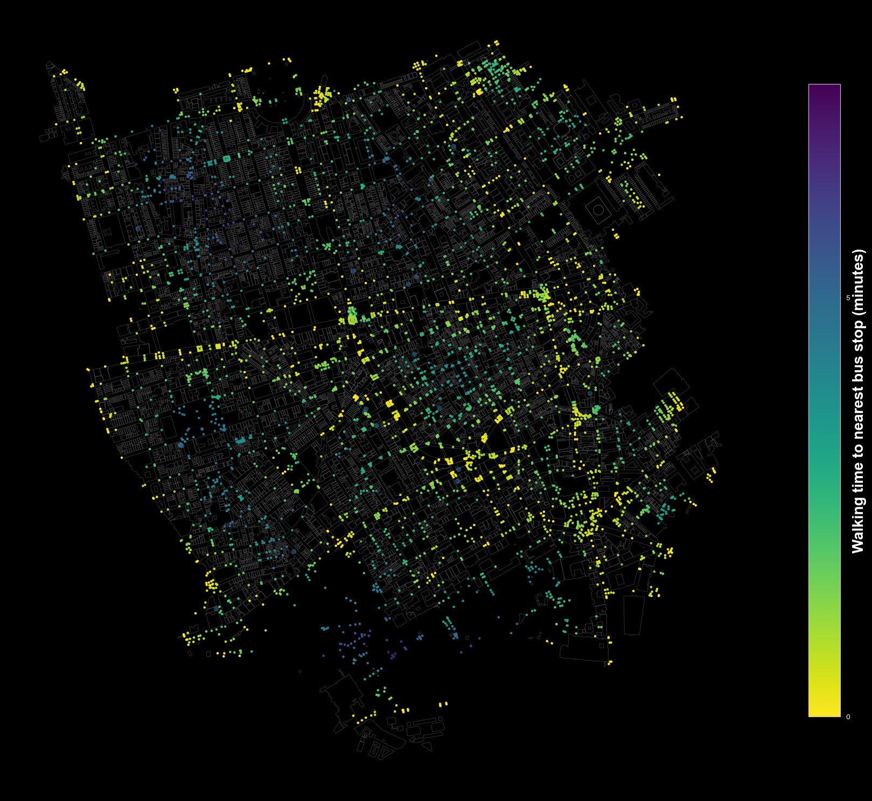
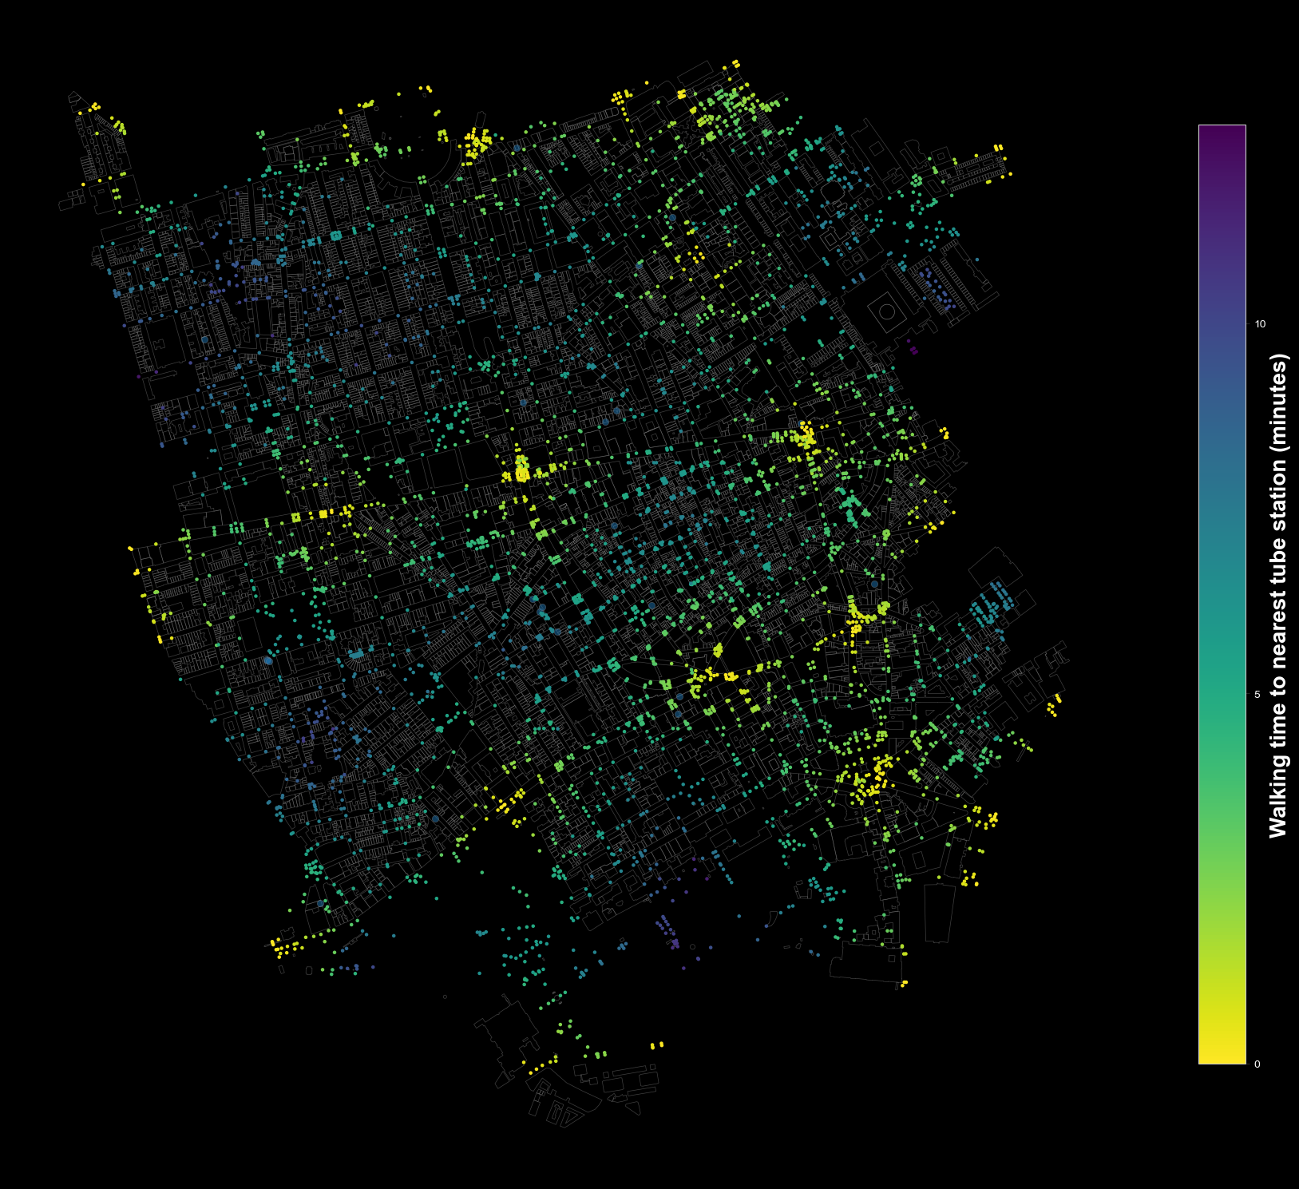
Traffic Accessibility – Stops & Stations
High availability and accessibility of public transport stations

Slide 11
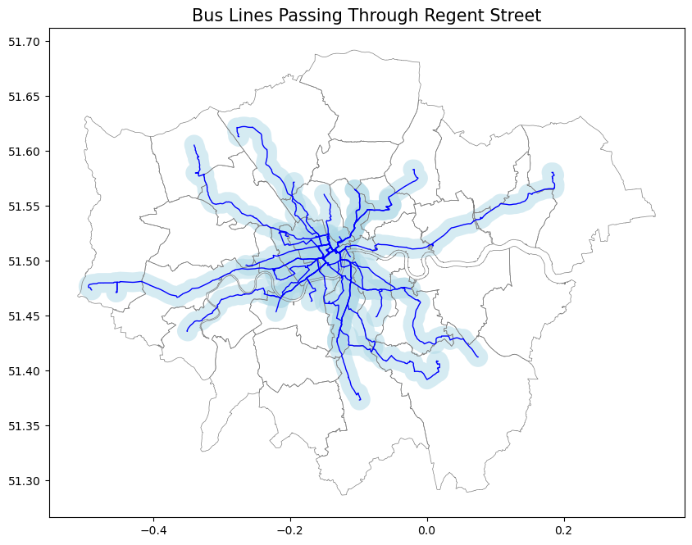
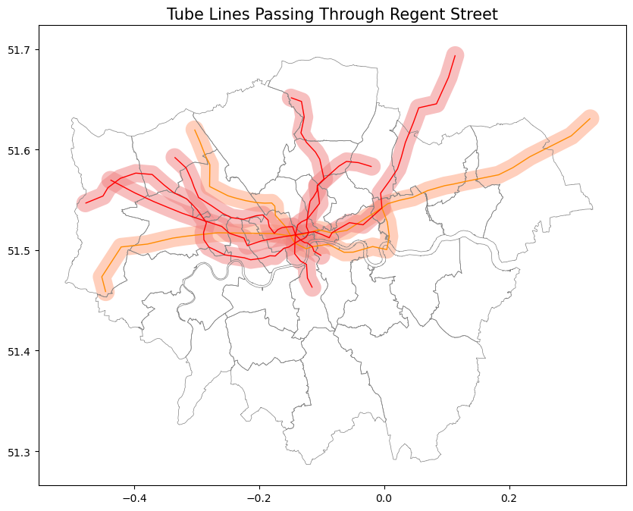
Traffic Accessibility – Transport Lines
Bus routes: 12, 22, 453, 88, N15, N18, N22, N3, N109, N136, 139, 159,
94, N113, N137, 14, 19, 23, 38, 9, N19, N38, N9, N97(Blue)
Tube lines: Bakerloo, Central, Victoria, Piccadilly line(Red)
Jubilee and Elizabeth line are also convenient (Orange)

Slide 12
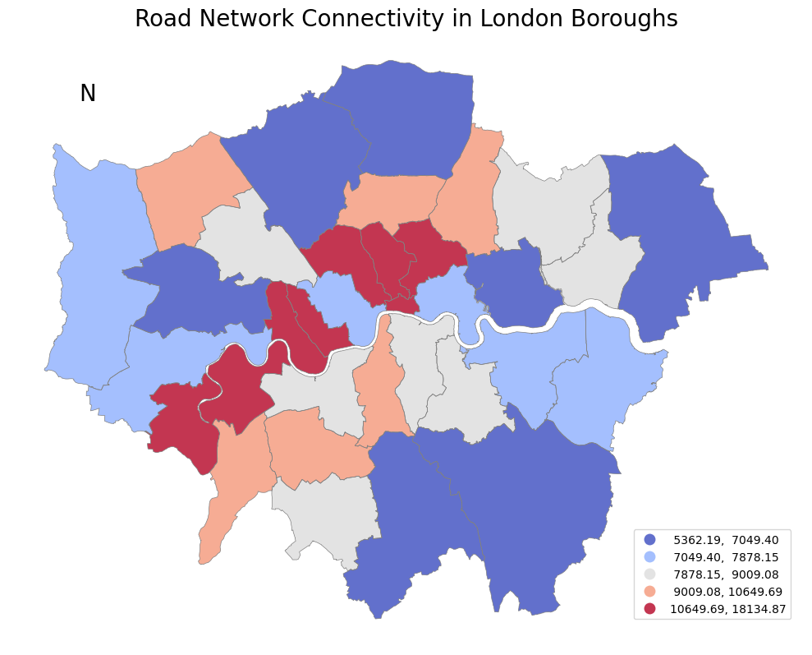
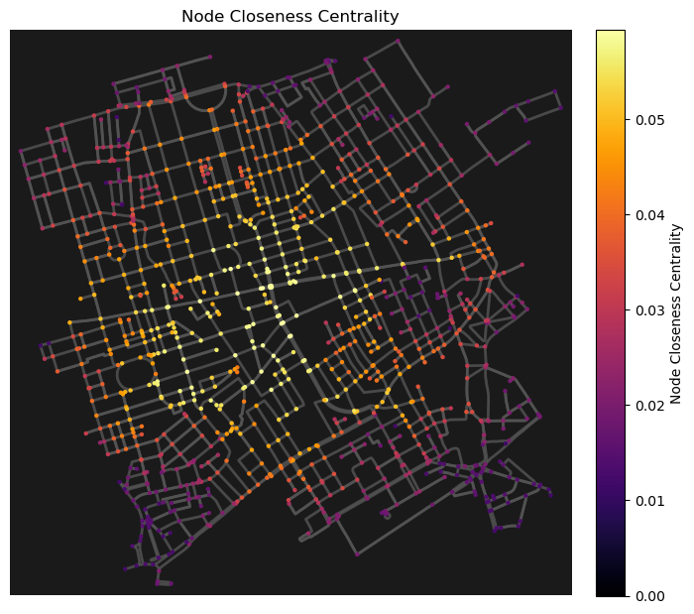
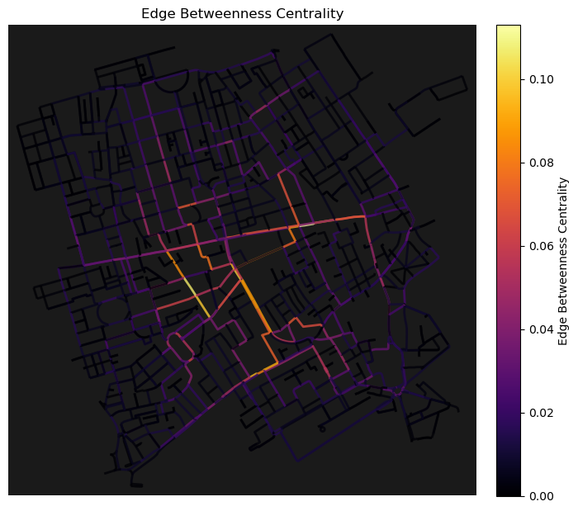
Traffic Accessibility – Road network
Roads are well-connected
Important roads: Regent Street, Oxford Street, Bond Street

Slide 13
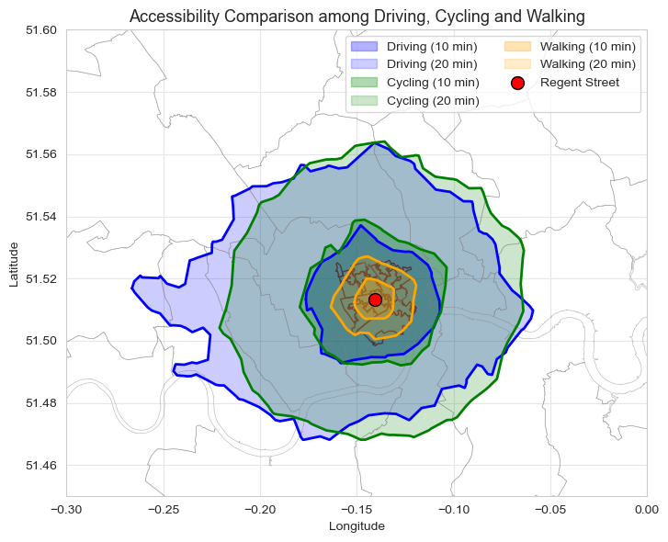
Traffic Accessibility - Isochrones
Ideal Isochrones:
Theoretical and static isochrones
20-minute walking isochrone can cover the region.
Clycling and driving have similar accessibility ranges.

Slide 14
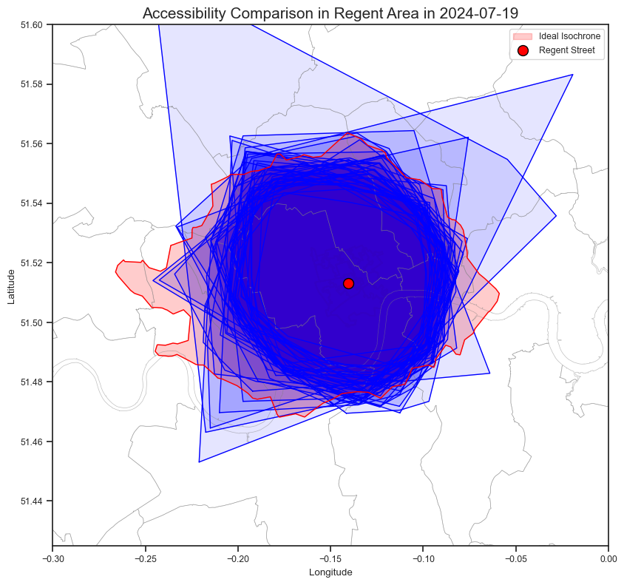
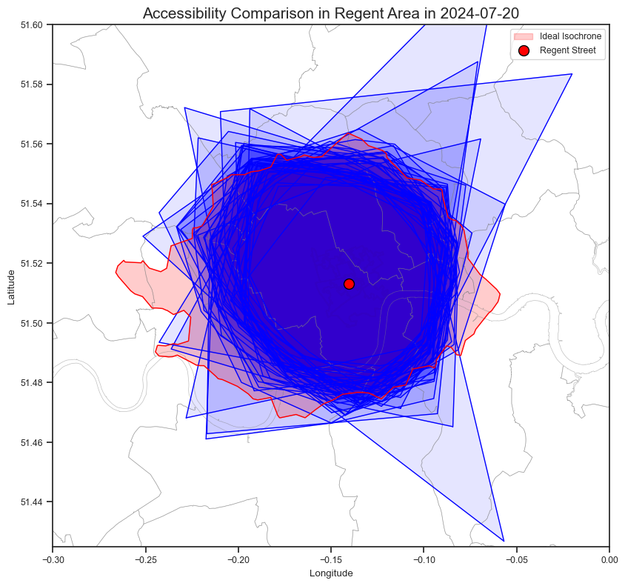
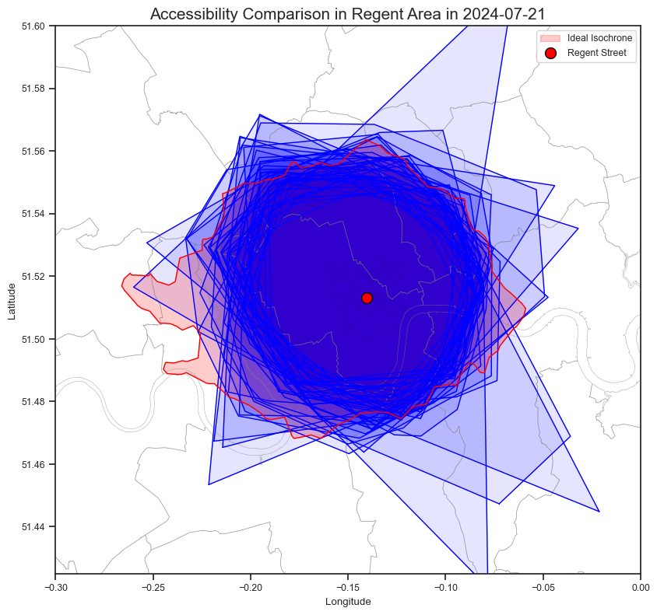
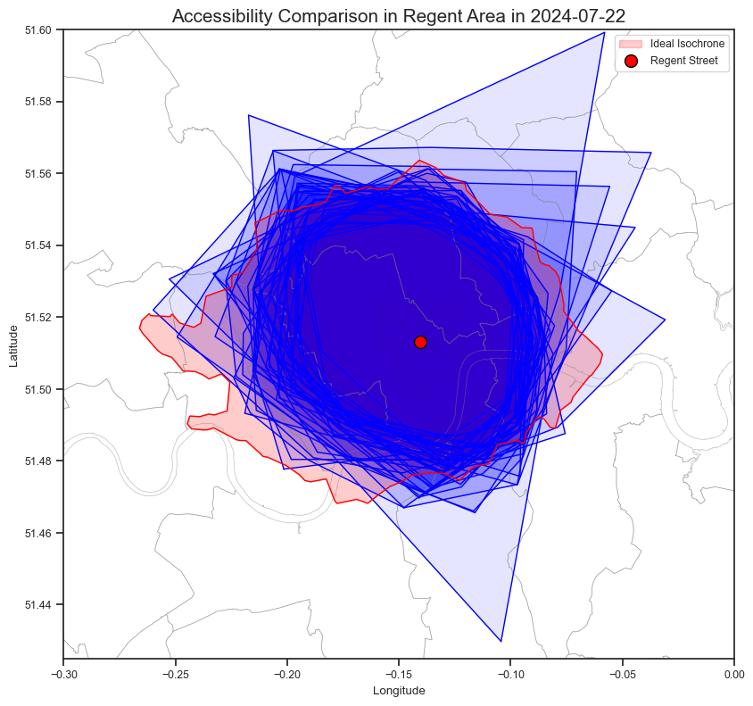
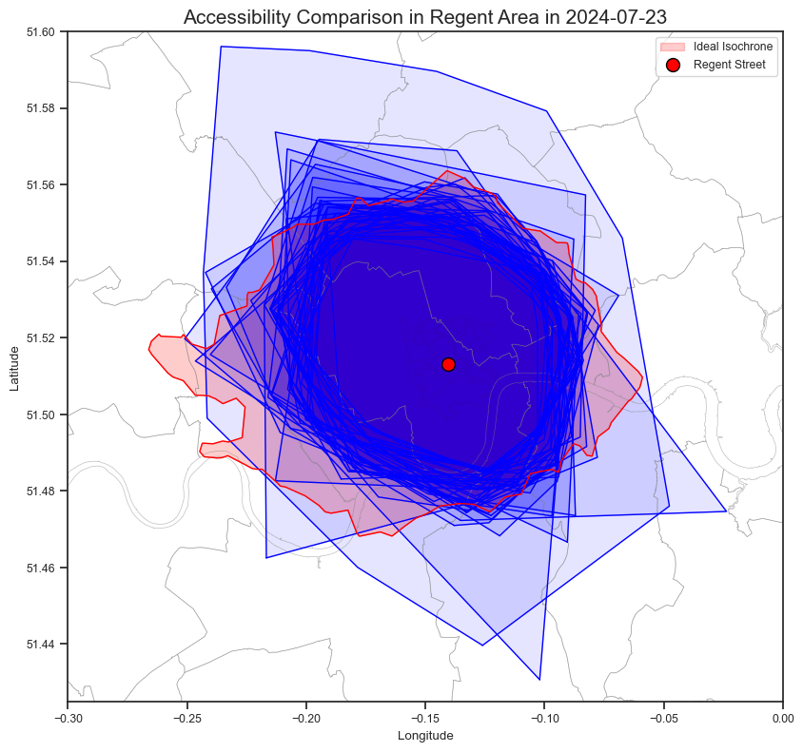
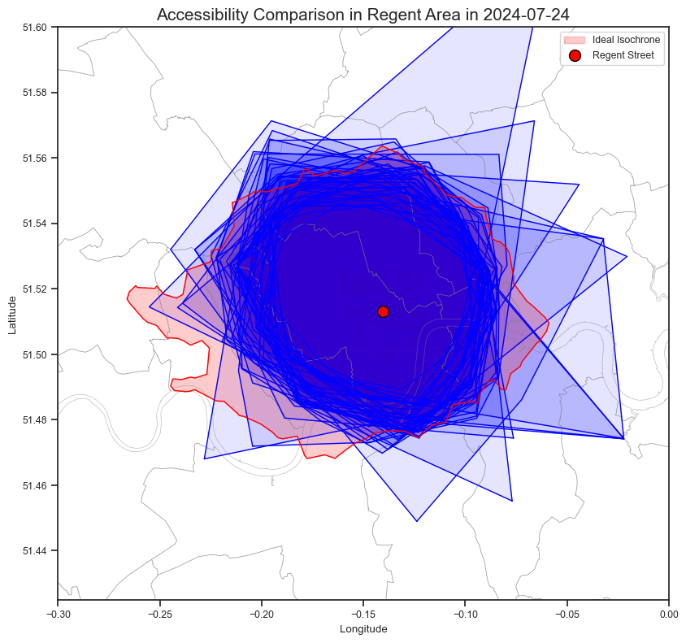
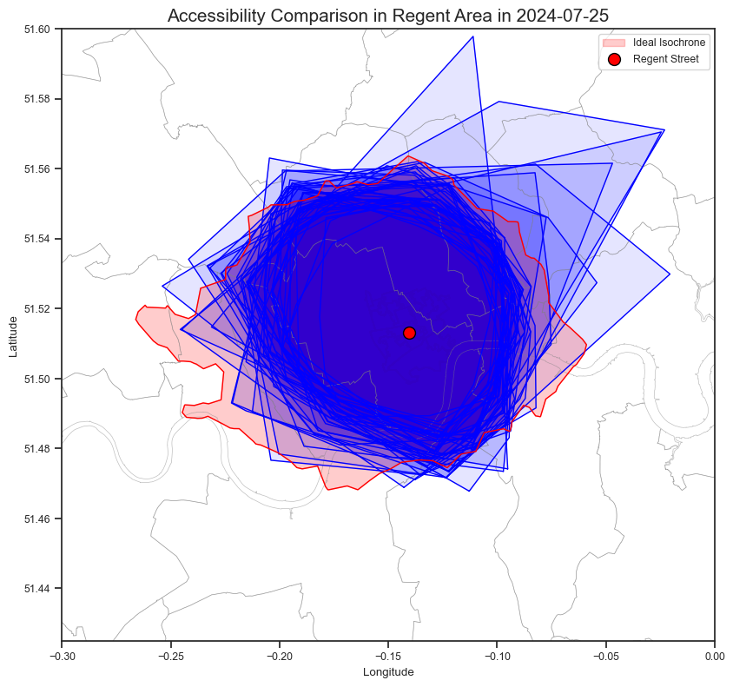
Traffic Accessibility - Isochrones
BODS isochrones: Real and dynamic

Slide 15
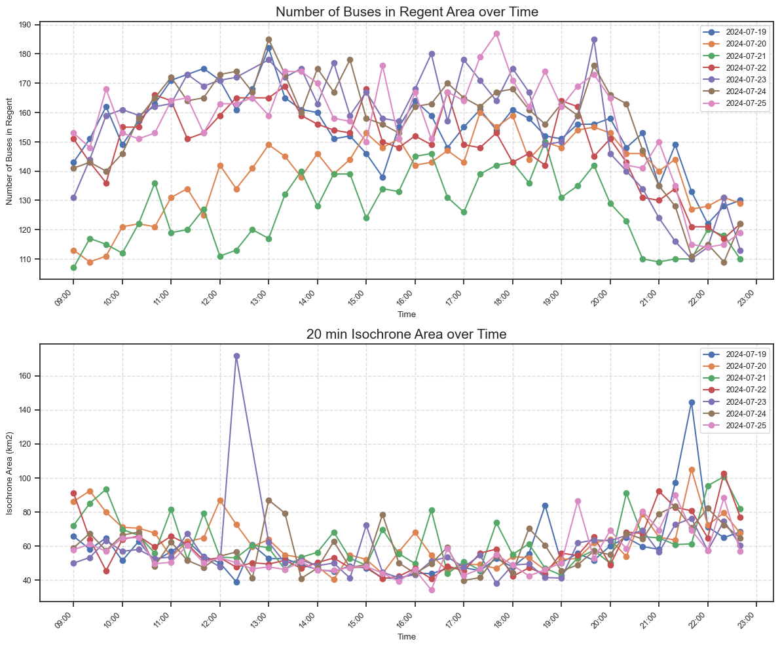
Traffic Accessibility - Isochrones
The number of buses:
Similar trends in weekdays or weekends
Buses are less on weekends
No significant difference between peak and off-peak
Isochrones area:
Relatively stable trends
High accessibility
No significant difference between weekdays and weekends

Slide 16
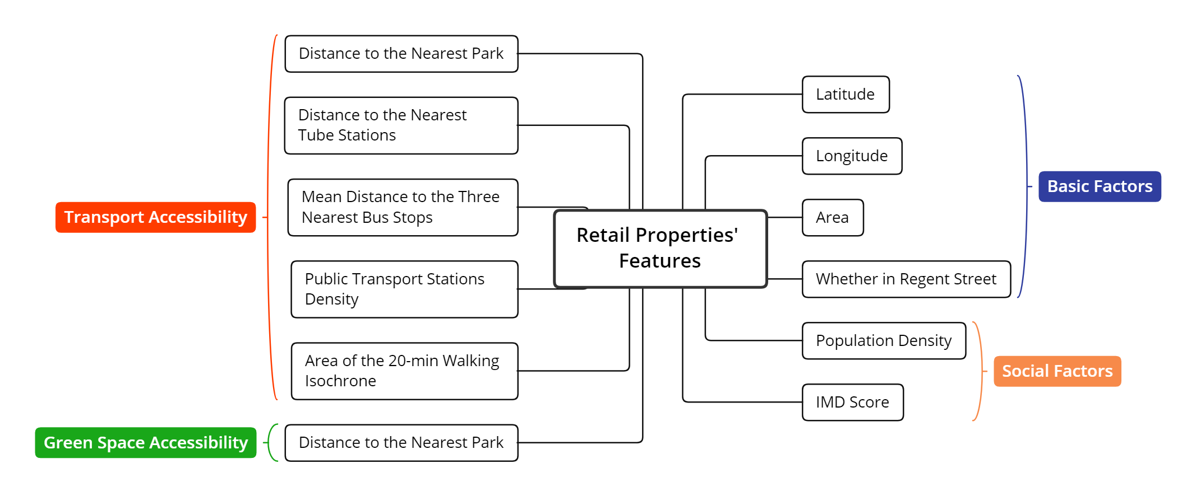
Hedonic Pricing Model

Slide 17
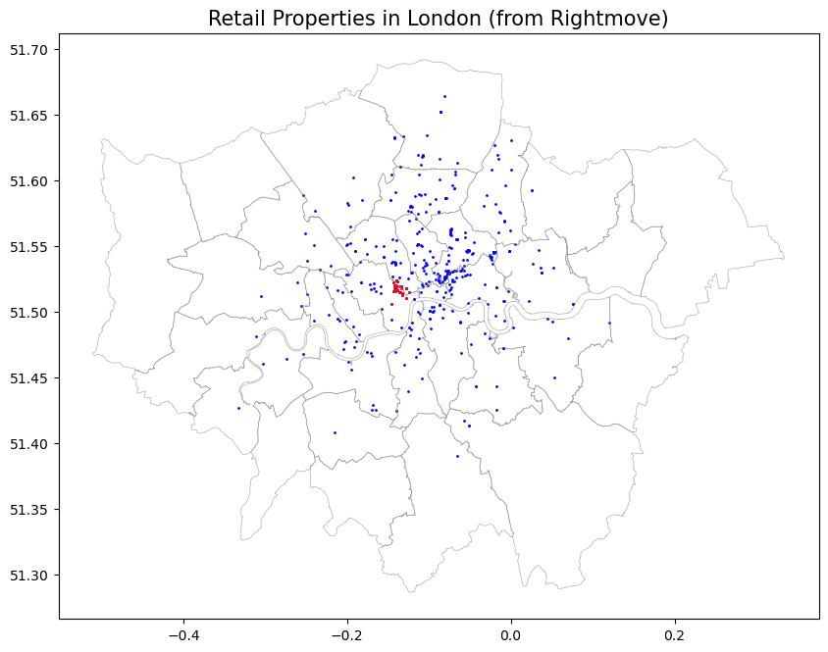
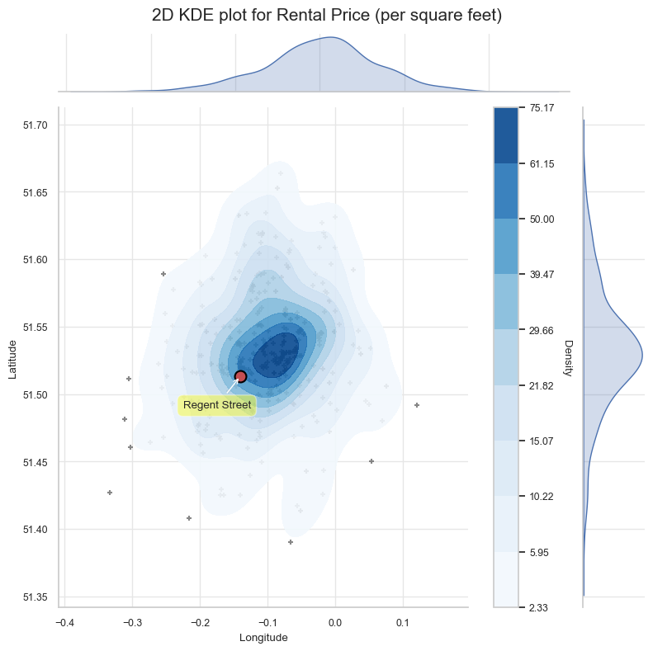
Hedonic Pricing Model
Overall: 401
Regent: 27

Slide 18
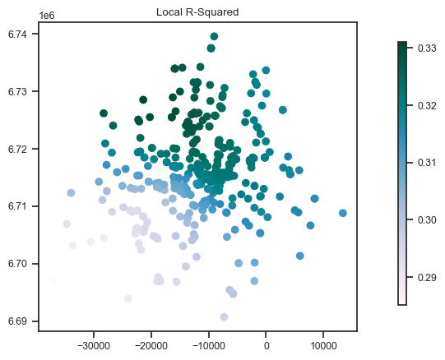
Hedonic Pricing Model
HPM models:
Ordinary Least Square model (OLS): does not consider spatial autocorrelation
Spatial Lag Model (SLM): cannot eliminate spatial autocorrelation
Spatial Error Model (SEM): R-squared is 33.35%
Geographically Weighted Regression (GWR) model

Slide 19
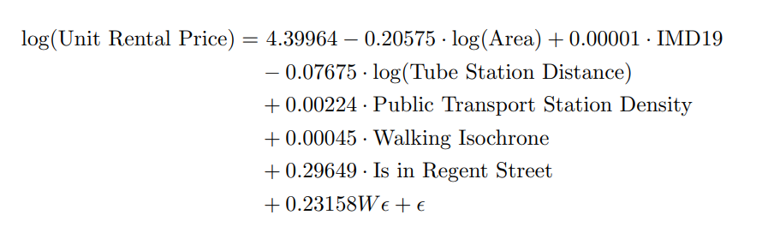
Hedonic Pricing Model
SEM:
Negatively correlated: Retail property Area, Distance to the nearest tube station
Positively correlated: IMD score, Public transport station density, 20-minute walking isochrone area
No significant impact: Population density, Distance to the nearest park, Mean distance to the 3 nearest bus stops
Premium of Regent Street: 34.5%

Slide 20
Conclusion:
Excellent geographical location
Transport stations have high availability and accessibility
Traffic lines and roads are well-connected
Green travelling friendly (walking, cycling, bus)
Cycling can be encouraged, and parking points can be planned
Green mosaics need to be planned
SEM is best to assume HPM
Bond Street Station and the Elizabeth line can be added as traffic suggestions on the Regent Street website

Slide 21
Thank You
GitHub: https://github.kcl.ac.uk/k23031223/YueMa_k23031223_NicolasHolliman_SupplementalFile_2023-24

